Slide 1
Minor Project
Presentation

Slide 2
IHA ( IOT enabled Hostel Attendance system)
Project Number: 71
Yash Raj Pandey (191B295)
Aryman Tripathi (191B309)
Samarth Dubey (191B304)
Mentored by: Mrs. Babita Tiwari

Slide 3
Contents
Overview
Requirements Analysis
Understanding the Problems
Project Objective
Target Audience
Tech Stack
System Design
Project Timeline

Slide 4
Overview
This particular project deals with the problems on managing a hostel and avoids the problems which occur when carried manually. This is an interesting concept set forth to automate the traditional attendance system by using authentication technique. The traditional system requires a register maintained for manually marking attendance for the students which is time consuming. Hence this proposed project eliminates the need of maintaining attendance sheet.

Slide 5
Introducing: IHA
The project is a system that takes down students’ attendance using barcode. Every student is provided with a card containing a unique barcode. Each barcode represents a unique id of students. Students just have to scan their cards using barcode scanner and the system notes down their attendance as per dates. System then stores all the students’ attendance records and generates defaulter list. It also generates an overall report in excel sheet for admin (that is warden).

Slide 6
Requirements Analysis
Software Requirements:
Android studio
Visual studio code
MySQL
Python 2.7 or above
Hardware Requirement:
Android or iOS Device
Barcode Reader
Local machine server

Slide 7
Features
Admin login: Admin is provided with a login from where he monitors and administers all the students' information and records.
01
02
Barcode Reading: Students have to scan their card through barcode reader and the id thus read by the system is stored for that particular day.
03
Defaulter list: The system generates defaulter list in excel sheet for specified period provided by admin.
04
Report generation: At the end of attendance process system automatically generates overall report for the class in excel sheet.
05
Search option: Admin can even search for particular student's attendance details using search option in the system

Slide 8
Project Objective
To create a fully functional attendance system to manage hostel student data.
Attendance Monitoring Helps To Manage And Allocate Rooms And Resources
Attendance Monitoring Reduces The Manual Work Of The Administrative Staff
In this hyper-competitive era, it is essential that this transformation not only meets all the needs but also exceeds the expectations of the parents.

Slide 9
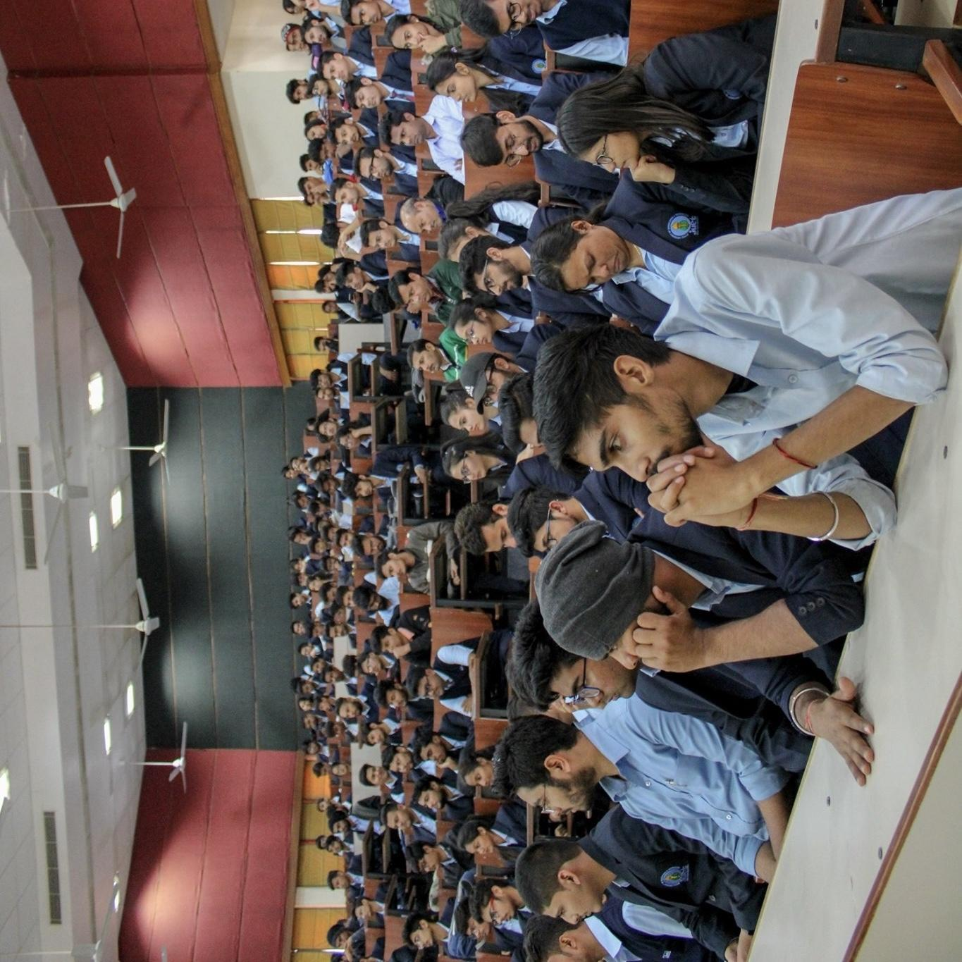
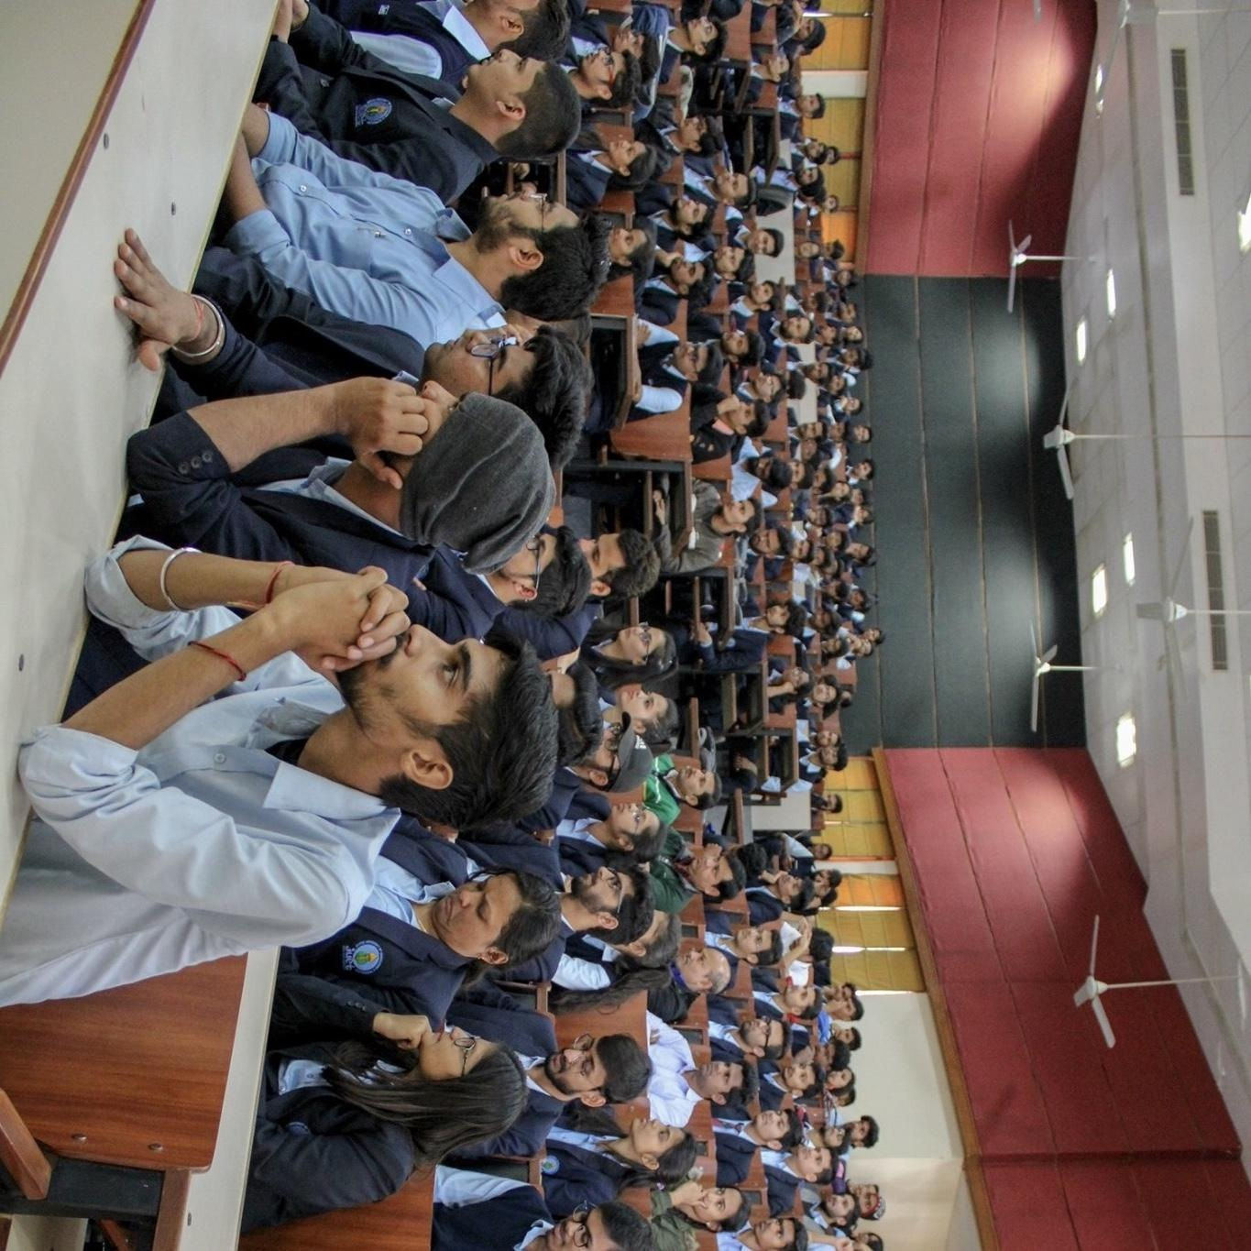
Target Audience
Hostel Attendance Management System is powerful, flexible and easy to use. It will be helpful in knowing whether any student is missing in hostel. It will help us to have a record about attendance of each student
We can show this information to the respective Parent of the student during their visit to the hostel. This is one of the best methods for securing the students. Easily we can enter and maintain Attendance detail in this project.

Slide 10
Tech Stack
Flutter
SQL
Python
Flask

Slide 11
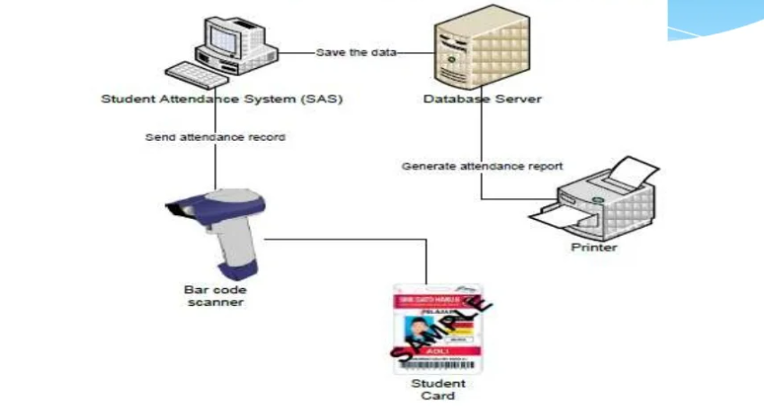
System Design

Slide 12
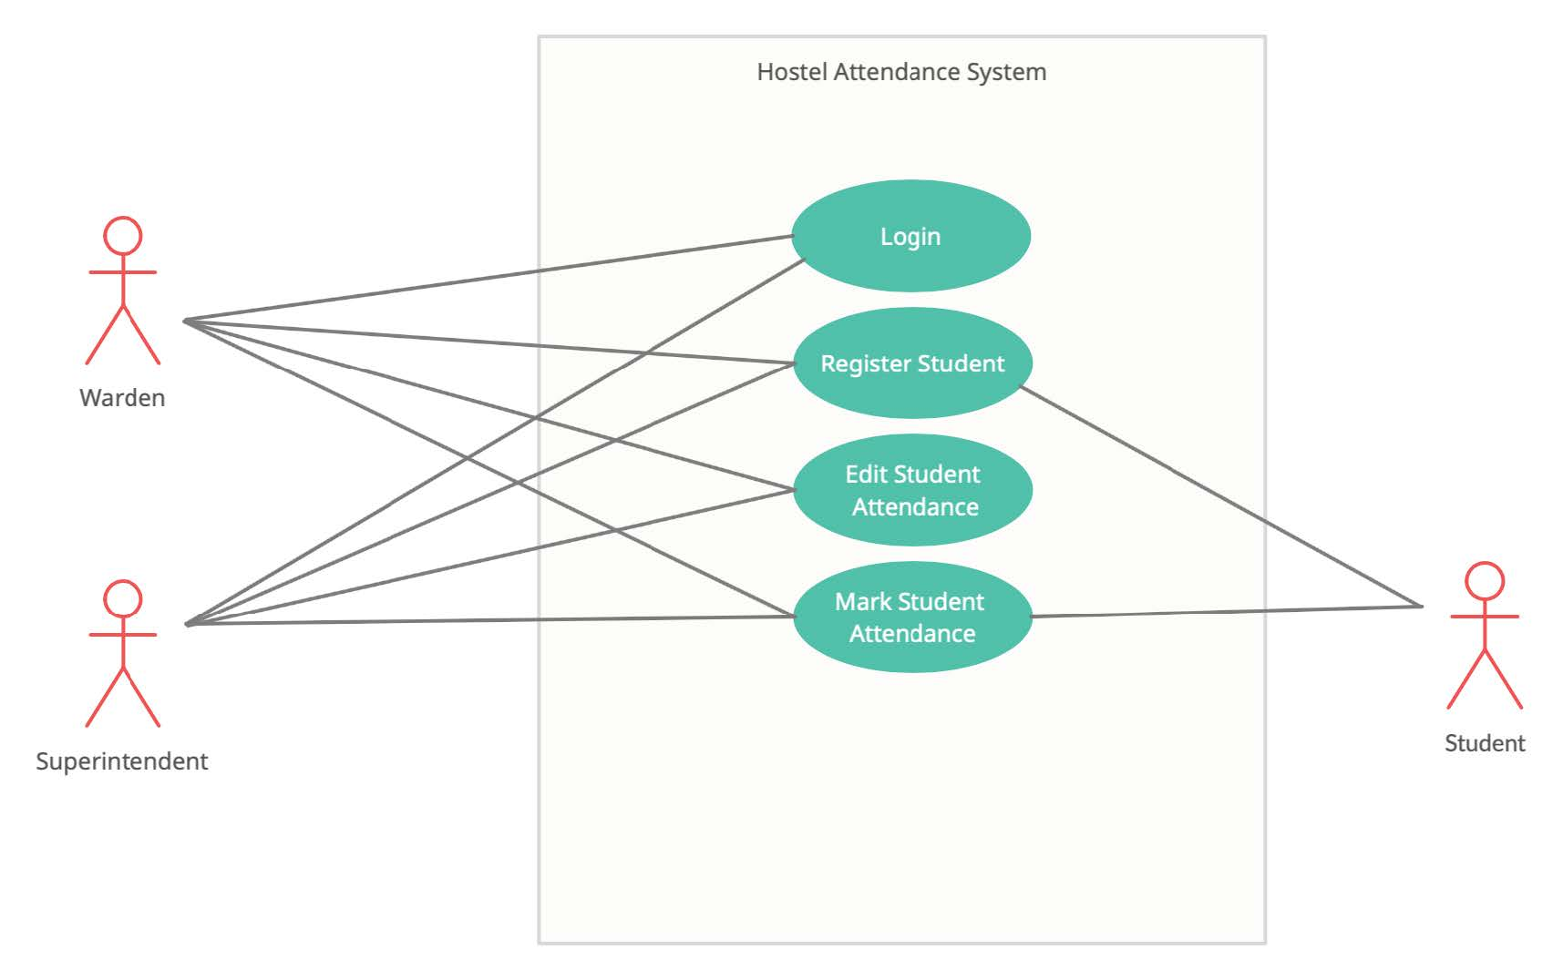
Use Case Diagram

Slide 13
Project Timeline
FEB
MAR
APR
APR
MAY
JUN
Planning and Defining
Designing
Frontend
Backend
Testing
Deployment
Planning about the basic overview and functionality of the IHA
Working on the icons, logos and several mockups of the app in realtime.
Going through the overall user interface of the application.
Working on the integration of the application with the Firebase.
We’ll be going through split testing phases in this stage.
Finally, After sorting out all the bugs and patches. We’ll be deploying the application.

Slide 14
Thank You!

